Slide 1




BGSKH Education Trust (R.) - A unit of Sri Adichuchanagiri Trust (R.)
BGS College of Engineering and Technology
Approved by AICTE, New Delhi and Affiliated to VTU, Belagavi.
Adjacent to Mahalakshmi Metro Station, Mahalakshmipuram, West of Chord Road, Bengaluru -560 086.
MINI PROJECT
Topic : Digital Notice Board
Under the Guidance of :
Mrs. Manasa C K
Assistant Professor
Dept.of CSE
Team Members :
Chandana Gowda - 1MP23CS014
Venugopal K R - 1MP23CS058
Sarvesh Pednekar - 1MP24CS0404

Slide 2
Introduction
A digital platform to display campus notices in real time.
Replaces traditional paper-based notice boards.
Provides fast, organized, and user-friendly information access.
Supports both admin and student users.
Ensures efficient campus communication.

Slide 3
Problem Statement
Manual notice updates take time and effort.
Paper notices cause clutter and waste.
Students miss important announcements due to distance or crowding.
No centralized system for categorizing and tracking notices.
Difficult to maintain and update multiple physical notice boards

Slide 4
Objectives
Develop a web-based notice management system.
Provide role-based login: Admin & Student.
Allow admin to add/edit/delete notices easily.
Enable students to view, search, and filter notices.
Display notices in categories: Circular, Event, Urgent.
Generate real-time statistics of notices.
Improve accessibility and reduce manual effort.

Slide 5
Implementation
Frontend built with HTML + CSS for layout and design.
JavaScript handles login roles, form validation, CRUD operations.
Data stored in browser local storage for quick access.
JSON import/export allows backup and restore of notices.
Dynamic DOM rendering for real-time updates.
Custom components: notice cards, filters, stats.

Slide 6
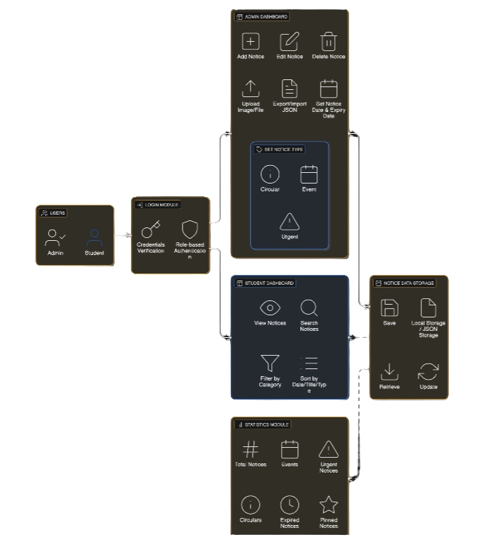
Block Diagram
Components:
User Interface (Admin/Student)
Login Authentication
Notice Management Module
Notice Display Module
Local Storage/JSON Storage
Statistics Module

Slide 7
Technologies Used
Frontend: HTML5, CSS3, JavaScript
Tools: Browser Local Storage, JSON Export/Import
UI Features: Responsive design, dark/light theme
Icons & Fonts: Google Fonts, SVG Icons
Testing Tools: Browser Developer Tools

Slide 8


Modules Description
2. Admin Module
Add new notice
Edit existing notice
Delete or pin notices
Upload images or attach files
Manage expiry date
Bulk delete and sorting
1. Login Module
Admin/Student roles
Username & Password validation
3. Student Module
View all notices
Filter by category
Search bar
Read-only access
4. Statistics Module
Total notices count
Count of circulars, events, urgent notices
Number of expired notices
Number of pinned notices
5. UI/UX Module
Theme toggle
Keyboard shortcuts
Responsive layout
Notice ticker for urgent updates

Slide 9
Features
The system allows both admin and student login.
The admin can easily add, edit, and delete notices.
Notices can include titles, dates, descriptions, images, and files.
Students can view all notices in a clean and organized layout.
Notices can be filtered by type such as Circular, Event, or Urgent.
A search bar helps users find notices quickly.
The system supports sorting notices by date, title, or type.
Expired notices are automatically identified.
A statistics section shows numbers of each notice type

Slide 10
Advantages
The system saves time and reduces manual work for staff.
Students receive information quickly and clearly.
It avoids paper usage and is eco-friendly.
Notices are neatly organized and easy to access.
There is no crowding around physical notice boards.
The admin can update notices anytime within seconds.
The system improves communication inside the campus.
It reduces errors and makes notice management easy.

Slide 11
Limitations
The system currently stores data only on the local device.
It cannot be accessed from different devices unless hosted online.
Only one admin login is available right now.
The system does not send notifications to users.
It requires internet hosting for real-time multiuser access.

Slide 12
Future Enhancements
Integrate with cloud database (Firebase/MySQL).
Add multi-admin system with permissions.
Develop Android/iOS app.
Add push notifications for urgent announcements.
Add QR code scanning for notice access.
Add AI-based notice recommendation system.
Convert into a centralized campus digital signage system.

Slide 13
Conclusion
The Digital Notice Board System efficiently replaces traditional boards.
Provides fast, organized, interactive, and paperless communication.
Enhances student engagement and admin convenience.
Can be expanded into a full-scale campus information portal

Slide 14


